Slide 1
Blood Vessel Disappearance in the Eye
Kaitlin Kelley
Mentor: Yoshi Odaka

Slide 2
Research Basics
Lang lab in CCHMC
Studying the process of vessel cell formation and death in the eye
Use mice models to test different gene involvement
Natural process
Pathological process
Observed two parts of the eye
Hyaloid
Retina

Slide 3
Techniques Used/Learned
DNA genotyping
qPCR (quantitative polymerase chain reaction)
Western Blot
Sample dissection
RNA purification
cDNA synthesis
Slide mounting

Slide 4
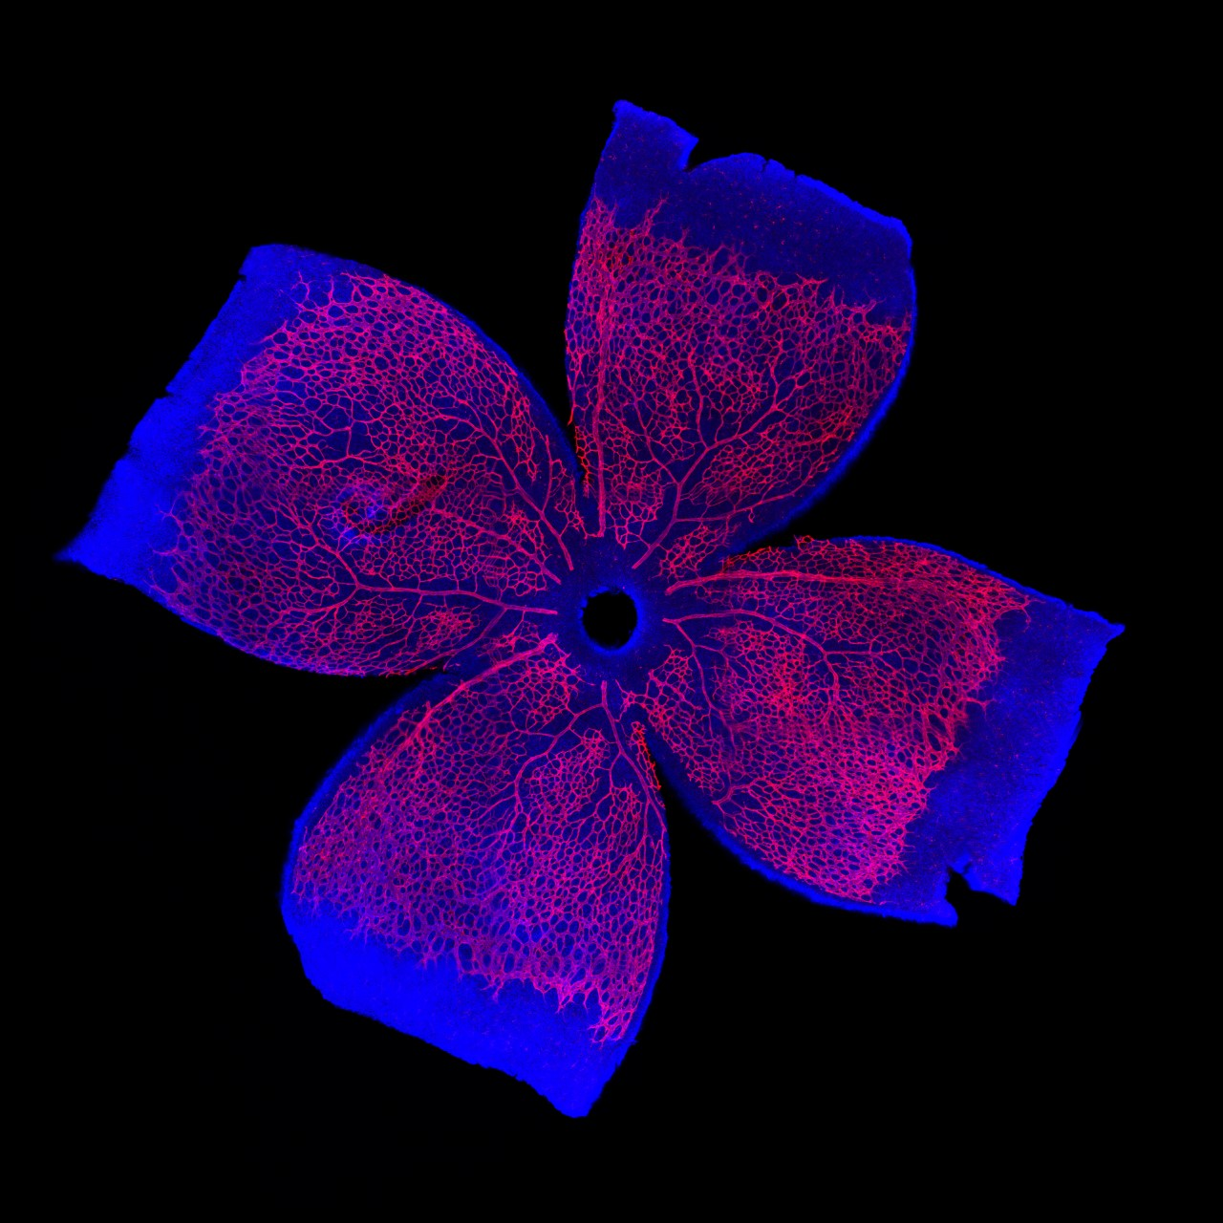
Outcomes
Desired
Actual

Slide 6
Relevance
If we can understand the process behind vascularization and devascularization, treatment for diseases become available.
Macular degeneration
Retinopathy (infantile and diabetic)
Cancer
Goal: diseases be treated at the source rather than simply treating the symptoms.

Slide 7
Relevance to me
Will continue during the summer
Gain more in-depth knowledge of pathways
Gained hands-on exposure to text-book knowledge
Saw the process of how research is conducted
Each step and why each is important
Trusted to work independently to finish procedures

Slide 8
Now what
Continue to gain more knowledge outside of my curriculum
Work with tissue samples and/or surgical nursing
Enjoy working on a project throughout the entire process
Satisfaction of a visual result that can be used to further the research

